Slide 1

EPS PREDICTION MODEL DEVELOPMENT
ADTA - 5410
Yog Chaudhary

Slide 2
AGENDA
Introduction
Data Cleaning & Feature Engineering
EDA Highlights
Model Selection & Performance
Recommendations Best Model
Concussion

Slide 3
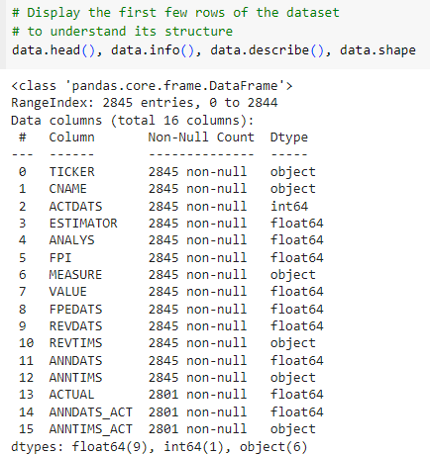
INTRODUCTION
EPS project developments of a predicated model for Earning Per Share for the client, Sink or Swim (SOS). Earnings Per Share (EPS) is used for the WRDS for the projects.
This dataset is crucial for forecasting future EPS values based on detailed analyst forecasts, helping SOS make informed financial decisions.
We provided by cleaning, processing, and applying statistical methods to this data, your goal is to develop a highly accurate tool for predicting EPS, enhancing the financial decision-making process at SOS.

Slide 4
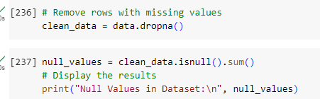
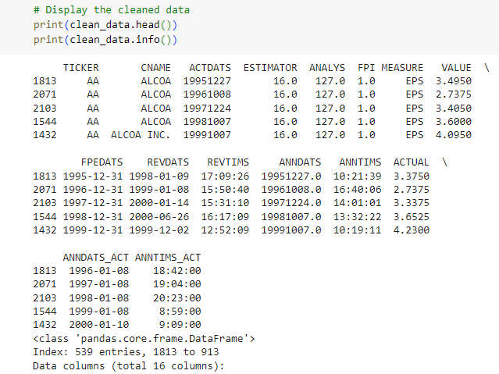

Data cleaning and Preprocessing
Handling Missing Values: ACTUAL, ANNDATS_ACT, and ANNTIMS_ACT columns had 44 missing values, Which were removed from the dataset.
Filtering Forecasts: Each financial year, utilizing “FPEDATS”, Only one most recent prediction from analysis from all forecasts.
Covert the ‘REVDATS’ columns to Date Time format for accurate sorting. After that taking clean_data

Slide 5
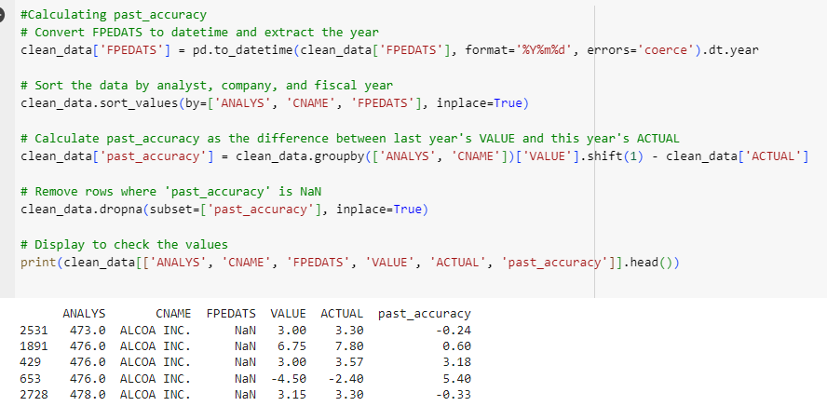
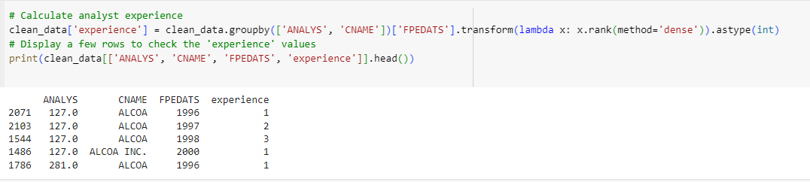
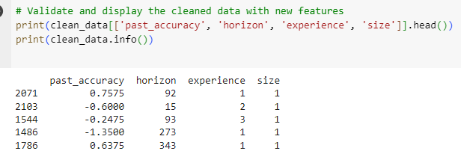
Featuring Engineering
Past Accuracy Calculation: We calculated a past_accuracy metric for each analyst individual’s forecasting effectiveness by comparing their last year’s prediction against actual EPS Results. It helps predict future performance as accuracy and null values appear for analytics company prior year data. Using instance for data constancy
Forecast Horizon: The horizon feature calculates the difference (ANNDATS_ACT - ANNDATS) between the forecast announcement and end dates, indicating prediction length."
Analyst Experience: The matrix clean data analysts have forecasted for EPS company of the financial statements.
Brokerage House Size: we calculated a matrix data analysis from some brokerage who forecasted for the same company in the same years.

Slide 6
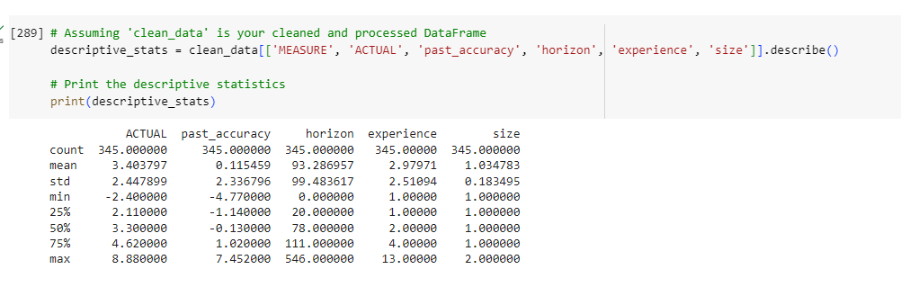
Descriptive Statistics
The metrics: ACTUAL, past_accuracy, horizon, experience, and size. The 'ACTUAL' values range from -2.4 to 8.88 with a mean of 3.4 and a standard deviation of 2.45, indicating variability in actual performances.
The 'past_accuracy' shows analysts' historical accuracy, with values spanning from -4.77 to 7.45 and a very low mean, suggesting mixed forecasting success.
The 'horizon' feature, measuring forecast timelines, averages around 93 days.
The 'experience' variable shows an average analyst experience of about 3 years. The 'size' variable, likely denoting firm or data size, averages at 1.03, suggesting minimal variation in this sample.

Slide 7
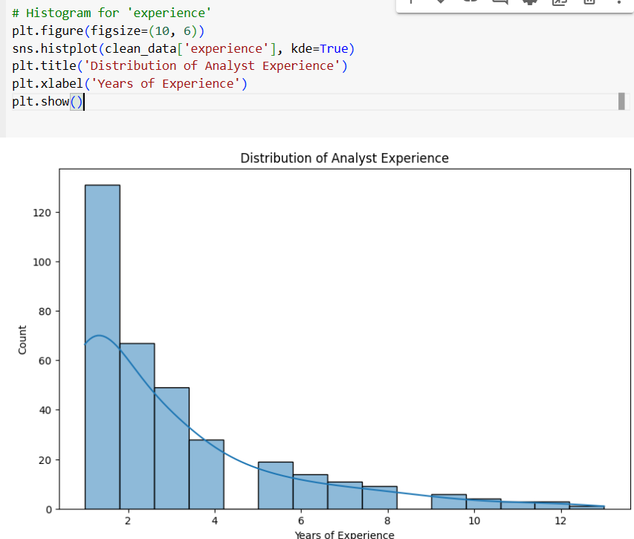
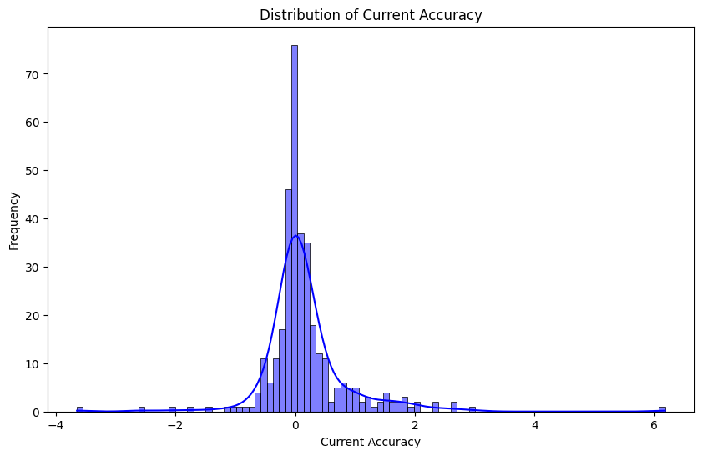
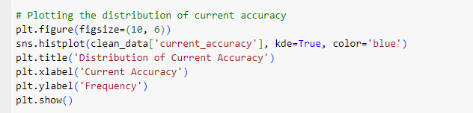
Exploratory Data Analysis (EDA)
The Histogram distribution of analytics between 0 to 2 years. Indicating a steep decrease in frequency with increasing expertise levels.
Using a kernel density estimate to a smoothed treated, there are a few analysts with more than 6 years of appearances with significantly fewer compared to those less experienced for long-term tenure in this field.
Distribution of Current Accuracy:
The distribution of accuracy values calculation by subtracting actual EPS from forecasted EPS.
most data points cluster near zero, indicating more accurate prediction, with a peak at zero.
Hances, this distribution exhibits slight right skewness, suggesting some forecasts tend to slightly overestimate EPS.
This skewness is visible through a longer to the right indicating the presence of several overestimates'

Slide 8
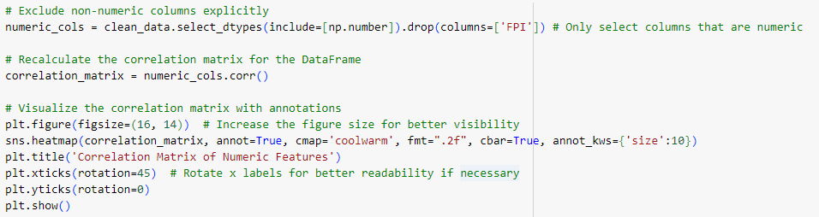
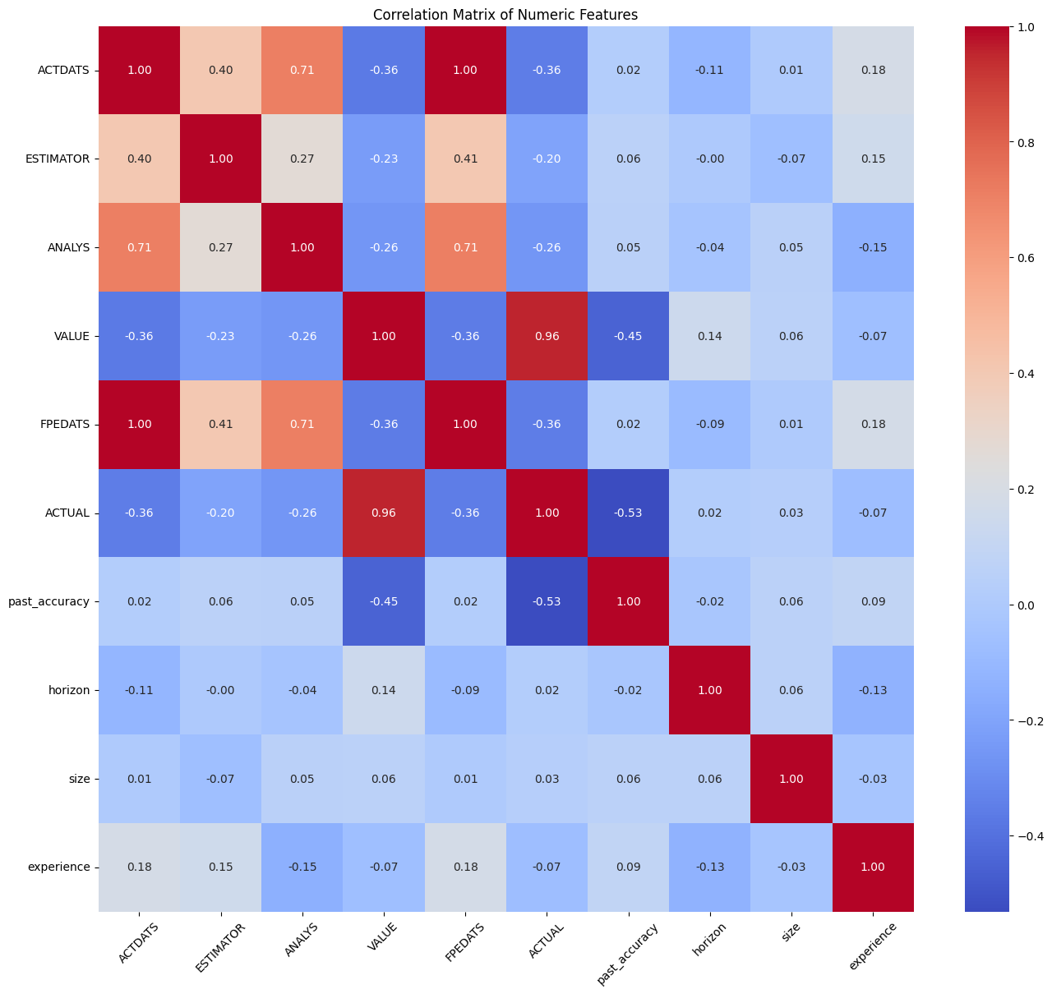
Correlation Matrix Analysis
We created a heatmap to visualize the correlation matrix, where each cell represents the correlation coefficient between numerical features."
The terms 'VALUE' and 'ACTUAL’ have a high positive and negative relationship correlation, we suggest that they directly measure EPS, making them highly predictive and crucial for modeling.
All associated with variables like ‘size’ or ‘experiences’ as well predicted for ‘ACTUAL’. This could be attributed to predicated models with the features.

Slide 9
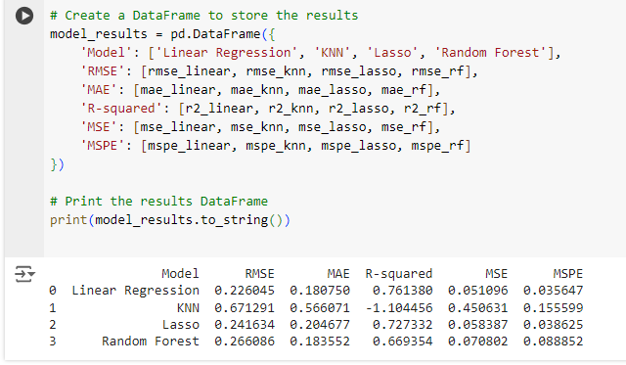
Model Selection and Performance
We have collected data, and all model Linear Regression, KNN, Lasso, and Random Forest have been trained with the training datasets. All the models for computing the MSPE. The MSPE will be the squares of the differences between the actual EPS Values and the prediction from each model calculated in the below screen showing the accuracy of forecasting EPS.
Linear Regression Model: Linear Regression Model a better than more complicated models like Lasso and Random Forest but a little higher than the KNN Model, linear regression provides an unusually low MSPE. This indicates respectable performances in which the linear correlation between the dependent variable (EPS) and the independent variables factors.
The validity of the model suggests that linear predictors have a significant correlation with EPS results. However, there may be non-linear or external variables that the basic linear model can adjust well values of MSPE 0.0356
KNN Model: RMSE was lower for the KNN model when compared to all of the models evaluated a low MSPE shows that the model forecast approximates the true EPS value of 0.1555
The idea behind KNN is that business profiles result in similar outcomes. Thus, the model performs well in the relationship in the feature spaces and has strong predicate outcomes.
Lasso Model: Lasso Regression, which includes an adjustment mechanism to reduce the impact of less significant characteristics, had a greater Means Squared Prediction Error MSPE, value of 0.0386, indicating less accurate prediction.
Random Forest Model: Random Forest, a team method that combines many decision trees to provide more accurate and reliable predictions, achieved the greatest MSPE of all the models tested. This high MSPE shows that the model is overfitting the training data, collecting both noise and signals in its predictions EPS, both Model Lasso and Random Forest indicated higher values between 0.0386 and 0.0888 respectively, predictions compared to the similar models.

Slide 10
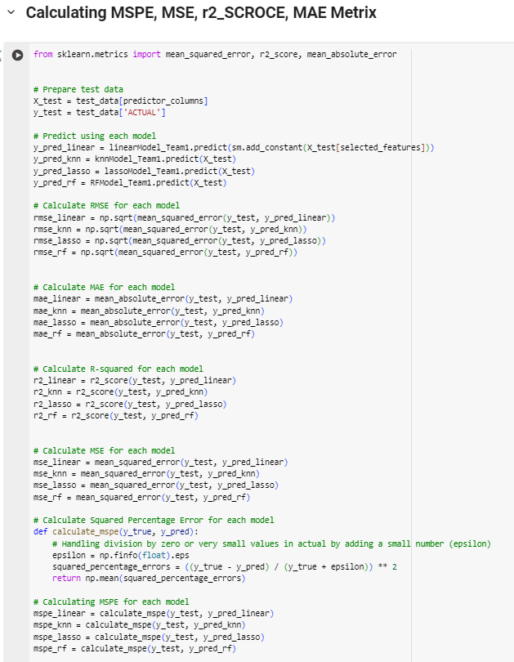
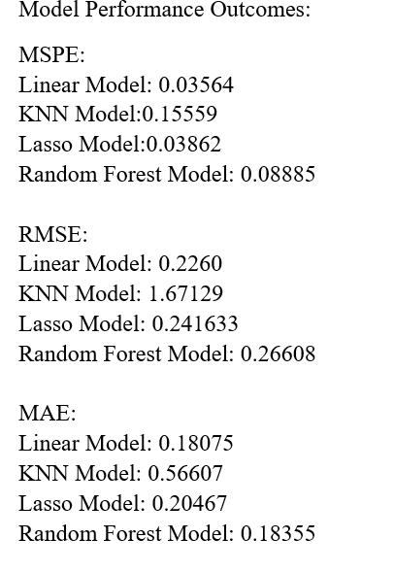
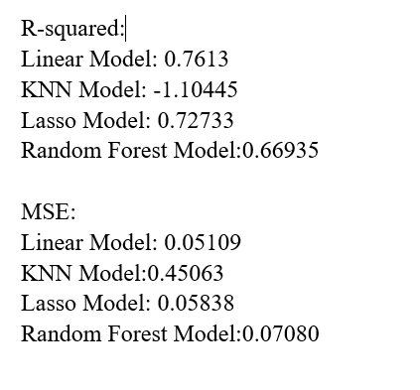
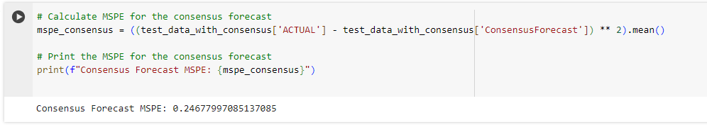
Evaluation Performance Model With MSPE, RMSE, MSE, R²
Mean Squared Prediction Error (MSPE): captures the average error between actual EPS values and prediction made by the mode.
Root Mean Squared Error (RMSE): Indicates the model accuracy in EPS prediction by measuring the magnitude of the error.
Mean Absolute Error (MAE): It measures the average error in the assets of prediction, without considering their decisions.
R-squared(R²): It is a statistical measure that represents the proportion of the variances for depending variables in the regression model the better fit data.
Finally, Linear regression model. The evaluations involved testing these model performances in each dataset. Using multiple statistical matrices for prediction accuracy and model effectiveness measurements for printing the matrix.
Consensus Forecast Calculation and MSPE
We calculated a mspe_consensus Consensus Forecast and MSPE for each analyst to evaluate from the actual values in the dataset test_data_with_consensus. The Consensus Forecast has an MSPE of values 0.247, which was higher than all individual forecasting models maintain the Lasso Regression. The MSPE measures the accuracy of the forecast, which indicates a lower value and more accurate EPS predicate.

Slide 11
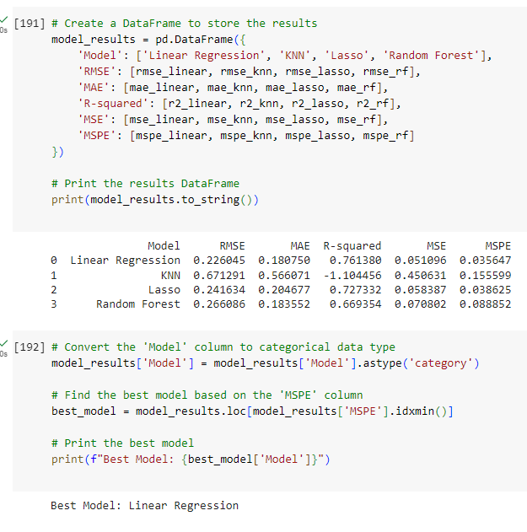
Application of the Best Model Performance
We have collected data, and all model Linear Regression, KNN, Lasso, and Random Forest have been trained with the training datasets.
All the models for computing the MSPE. The MSPE will be the squares of the differences between the actual EPS Values and the prediction from each model calculated in the values.
The models are evaluated based on metrics like RMSE, MAE, R-squared, MSE, and MSPE. Linear Regression is identified as the best model, determined by the lowest Mean Squared Prediction Error (MSPE).
We use Model columns for best printing Linear Regression Model

Slide 12
Conclusion and Recommendation
The Linear Regression Model has exceptional performance with the lowest MSPE of 0.0356, which indicates its outstanding ability to identify patterns in EPS predictions. The consensus forecast. Which has a mean squared prediction error MSE of 0.051 Indicates a strong performance higher than all models except for Lasso Regression.
The Linear Regression Model should be further enhanced by altering weights and 'k’ values, Using the k-fold validation. The consensus forecast should be commonly utilized as a valid benchmark. To increase model accuracy, other data sources or features could be investigated.
Finally, the benchmarking process involved evaluating the performance of the consensus forecast using the Mean Squared Prediction Error (MSPE), a metric that quantifies the average squared differences between the actual and forecasted EPS."
The MSPE value of 0.0356 indicates the average squared deviation between the forecasted and actual EPS values. Our models help people like the CEO, plan to predict a company’s future finances and decide whether it’s a better idea to invest in the company’s stock.
References
https://fastercapital.com/content/Forecasting-EPS--Predicting-Future-Earnings-with-Accuracy.html#Making-Informed-Investment-Decisions

Slide 13


